Slide 1

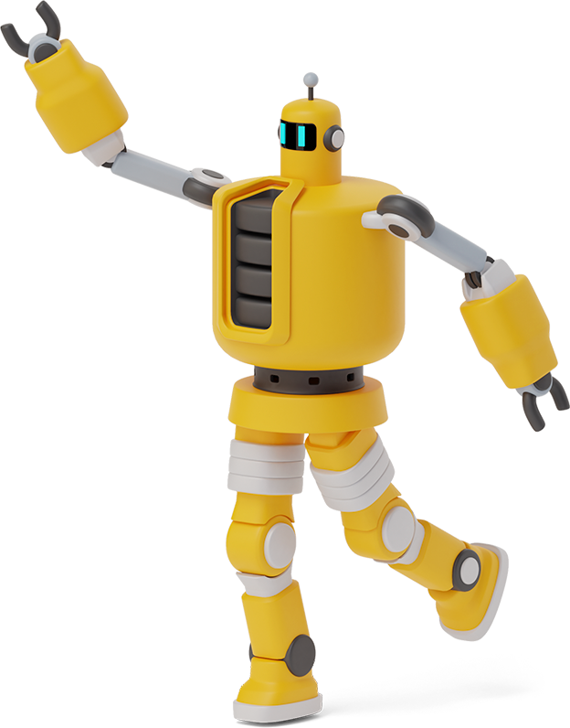
ChUck
A robot that plays Checkers
By Tyler Costello, Nicholas Kenny, and Aidan O’Hare

Slide 2

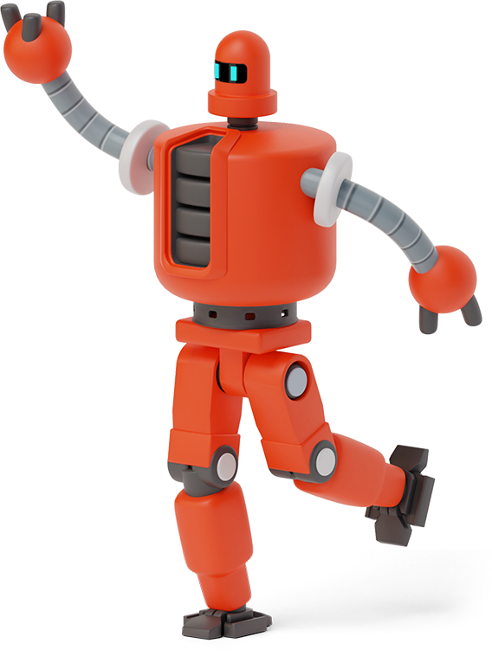
Intro and Motivation
1
The whos, whats, and whys…

Slide 3
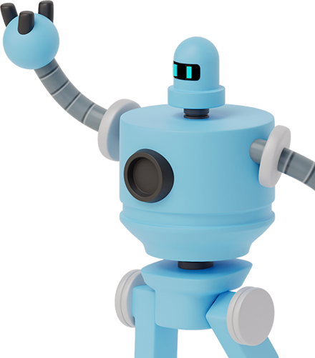
“Education should learn from the positive side of gaming - reward, accomplishment, and fun” - Sebastian Thrun
Notes:
We want to start our presentation with this quote from, Sebastian Thrun, who is a highly influential computer scientist, entrepreneur, and educator known for his contributions to AI, robotics, and self-driving cars.

Slide 4
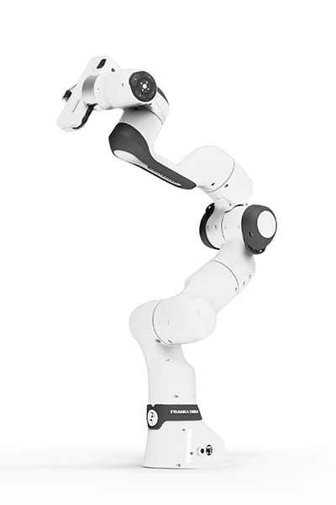
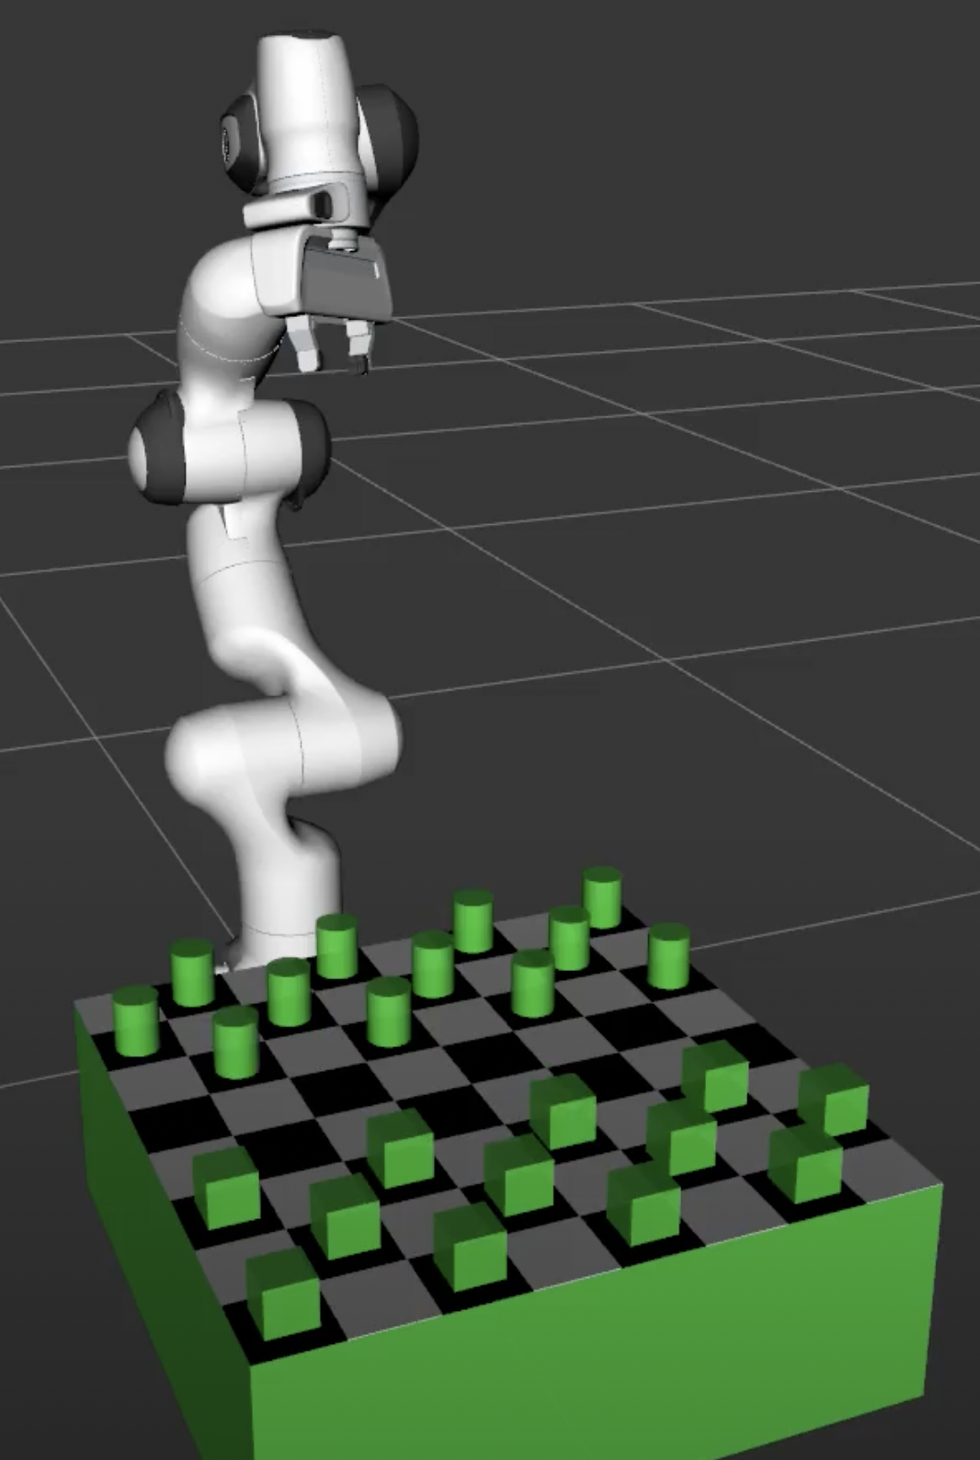
INtro
Notes:
We are using the Franka Emika Panda Robot, and prior to this, we only worked on a pick and place project in ROS.
In checkers (also referred to as dama in Greek), pieces move diagonally forwards and take opponents pieces by jumping over them. The cylinders at the top of the board are player one’s pieces, and the cubes at the bottom are player twos pieces. When your piece reaches the row on the far side of the board, it becomes a king and can move forwards or backwards diagonally from then on. To win, you must capture all of your opponents pieces by jumping over them into an empty square behind them. This is a two player game, not an AI.

Slide 5
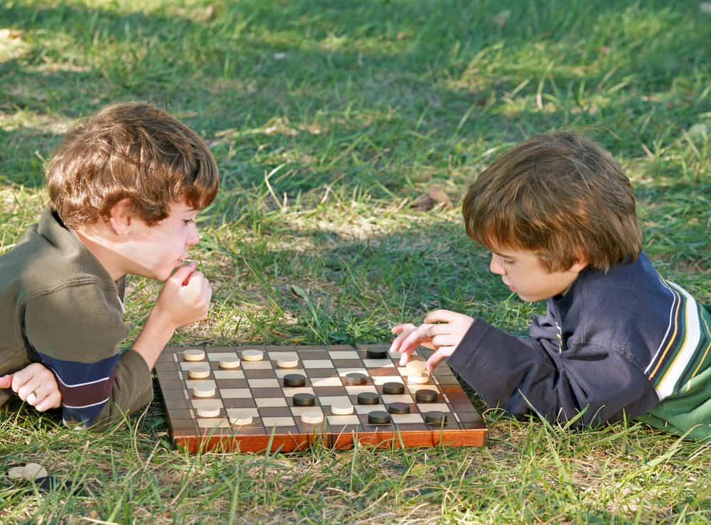
Motivations
Games are fun
Checkers is one of the first games people learn
Teach people about what robots can do
Notes:
Games are fun and teach us very important skills like mutual respect, strategy, coordination, and much more.
Checkers is one of those games that we often played when we were young, so we thought,
why don’t we teaching people about robots and what they can do with a simple game that most are familiar with.
Our game seeks to teach people about how powerful robots can be using the simple game of checkers.

Slide 6
Tasks
2
How did we do what we did

Slide 7
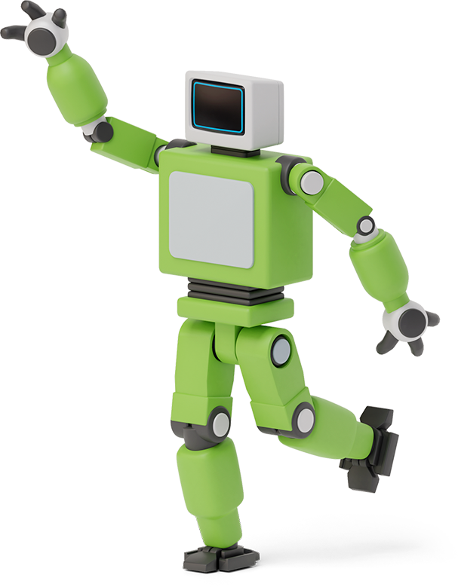

TWO main Parts
Checkers Game Logic
Executed by Tyler and Aidan
Checkers Gameplay Scene
Executed by Nick

Slide 8
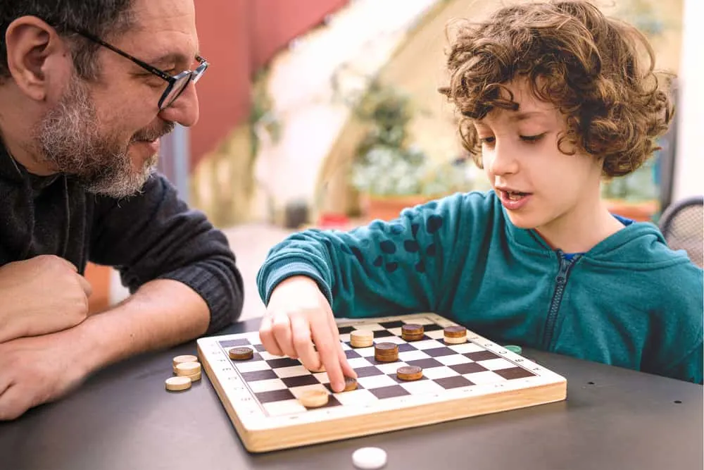

Checkers GAME LOGIC
Checkers is pretty easy for humans
A little trickier for a computer
We need to explain rules to computer
We did it using a Python Class
Notes:
There are two main things the game logic should do. The first is to check if the game is over and who won. This was fairly trivial, as the game is over once all the checkers belonging to a player have been taken, or one of the players forfeits. The second, is to keep track of the state of the board, and to check if the move a player submits is valid. This is where the majority of the code for the logic went to. We decided to represent the board as an array, with a 0 meaning an empty space, 1 meaning player ones checker and a 2 meaning player 2s checker. Also checkers can be kings, which means they can go forward or backward. So we also made it so that 3 represents player 1s king, and 4 represents player twos king. We decided to use a 8x8 board, because that is the traditional checkers board size. The code allows for all the standard moves of checkers, like kings and sequential takes, which happen when a player wants to jump 2 or more of the opponents checkers in a row. The code is also written using the object oriented paradigm, to make debugging and understanding it easier.

Slide 9
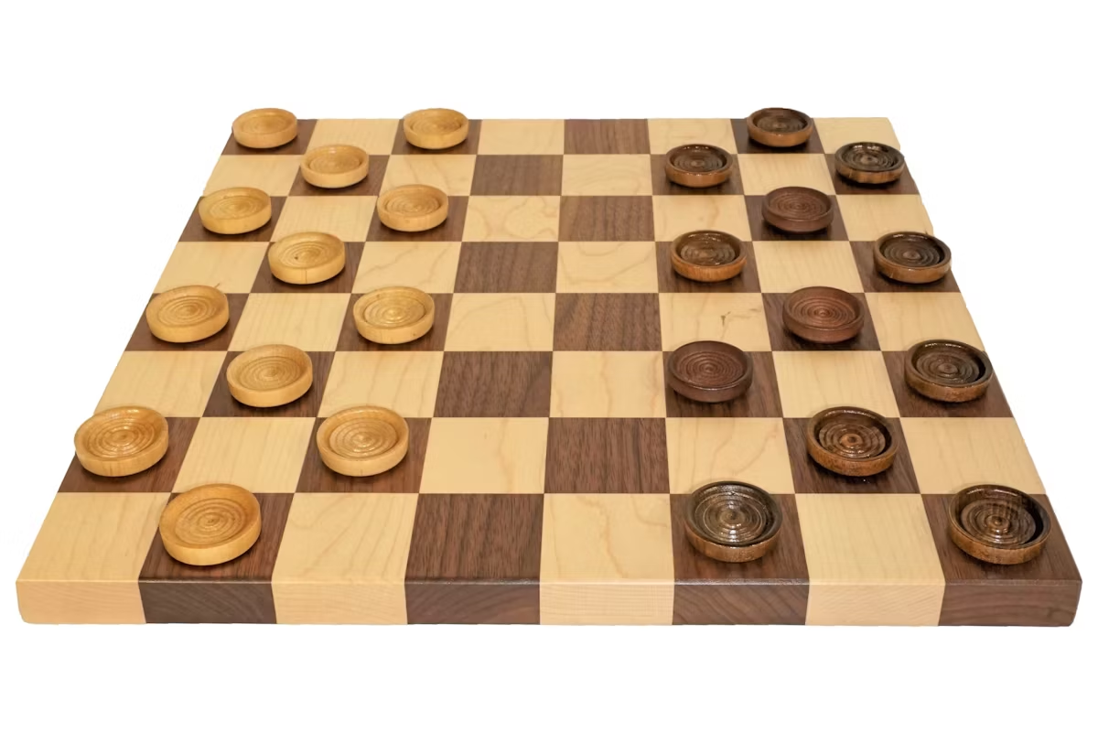
Checkers Gameplay SCENE
Components
robot
table
checkerboard
pieces
How to setup board?
How to keep track of pieces?
How to move pieces?
Notes:
To setup the checkers environment, I began with the Python MoveGroup tutorial from the previous lab.
This tutorial yielded me the robot and environment models which I needed to add onto for this project.
Then I created the table using a size of 0.56, 0.56, 0.2 which I decided upon by using the MoveIt Motion Planning API
to manually move the robot to all edges of the board to make sure the robot could reach all the pieces.
I went with the largest board I could use because this would reduce the amount of possible collisions by keeping the pieces as far apart as possible.
Then I added a Marker Array on-top of the table to represent the checkerboard so that the user can understand where the pieces are going.
To create this Marker Array I ended up creating a for loop to create all the squares, so I augmented this loop to added the pieces at the same time.
This enables me to call one function to create the checkerboard arrangement upon start-up of the game.

Slide 10
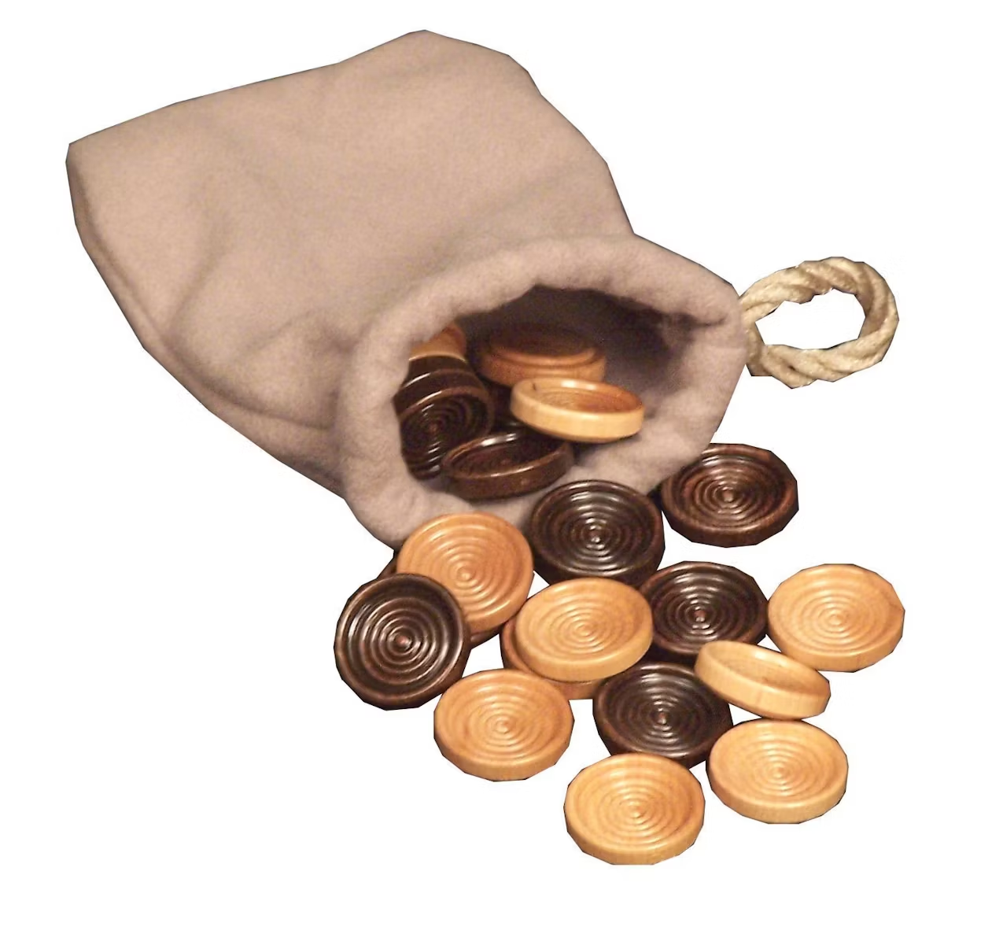
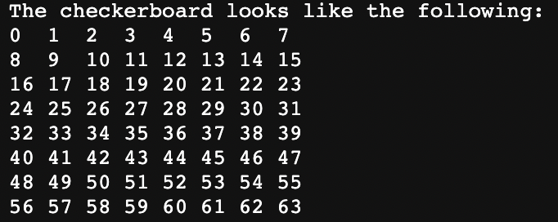
Checkers Gameplay SCENE
How to keep track of pieces?
How to move pieces?
Notes:
When adding the pieces into the scene, each box is named using an id in form “box i_j ” which establishes where the piece starts using i (rows in the x direction) and j (columns in the y direction).
Additionally when creating the pieces, I added the piece names to a dictionary which keeps track of the current location of the piece using an integer from 0 to 63.
This location number refers to specific squares on the board where 0 is the top left corner and 63 is the bottom right corner. Player 1’s pieces start on the top, and player 2’s pieces start on the bottom.
To move the pieces, a function in the checkers game logic class calls a function from the gameplay controller. This function takes in the starting position, goal position, and optionally the location of a piece to delete (if an opponent’s piece is getting jumped).
The logic on the gameplay controller then checks the dictionary using the integer location and finds the name of the piece that is at that location, for example box0_1.
Then based on an algorithm that yields cartesian coordinates for the robot, the robot can move to the desired piece, and pick up the piece with the id that was identified earlier.
The robot will then return to its home position, and then move to the next location which the user gave.
Once the robot reaches the desired position, it will detach the piece and update the dictionary with the new location of the piece. Then the robot will return home.
If a piece is getting jumped, it will be deleted from the scene and dictionary before any movement occurs - this reduces possibilities for collisions.
In total 4 trajectories are planned.

Slide 11
Challenges
3
Problems Problems Problems

Slide 12

Game Logic Problems
Pieces become kings when the reach the end of the board
Kings behave differently from normal pieces, ie. can move both forwards and backwards
Pieces can double jump
Notes:
Once we got all the regular pieces working correctly, which took a considerable amount of debugging, we then had to figure out how to make it so that kings would work on the board as well. We solved this by abstracting the original methods, so that they could be called by normal pieces or by kings, instead of writing whole new methods for the king pieces. Another issue is that in certain situations pieces can jump more than once, but there may also be times when the user does not want to jump the maximum number of pieces. We solved this recursively calling a function every time the user jumps, so that the user is queried if they want to continue using that piece to jump.

Slide 13
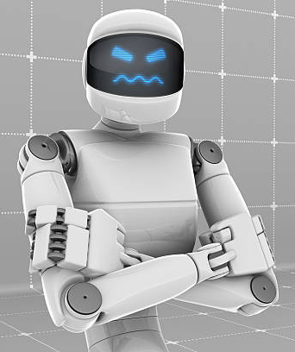
Scene Problems
Python Documentation
Marker Arrays
Boxes have fixed color
Imperfect Path Planning
Forgetting to delete pieces
Notes:
After the development that I have done in ROS, it’s pretty clear to me that most people use C++ to do this, so finding any relevant documentation in
Python was a big struggle. I was lucky since most of the methods carried over, but in general ROS documentation is not the easiest to read through and learn.
One of the early on issues that was a symptom of this documentation trouble, was MarkerArrays, which at the time, no one in lab knew how to use including the T/As. Learning how to configure MarkerArrays took me around 4 hours but was critical to developing the rest of the game.
After the board was created, then I could work on making the pieces. It only took me a few minutes to figure out that boxes have a fixed color for some reason in ROS. This is when I made the choice to make one player’s pieces cylinders and the other player’s pieces cubes; if different colors was not possible, shape would have to do.
Since the boxes and marker array were created using cartesian coordinates, it made logical sense to use it for my path planning operations too. This meant I had to learn how cartesian planning worked and then implement the movement algorithm detailed earlier.
The last issue was pretty small, but essentially I forgot to delete pieces from the dictionary when I deleted them from the scene, so that was causing weird bugs in game logic.

Slide 14
COllaboration
4
Team Work makes the Dream Work

Slide 15
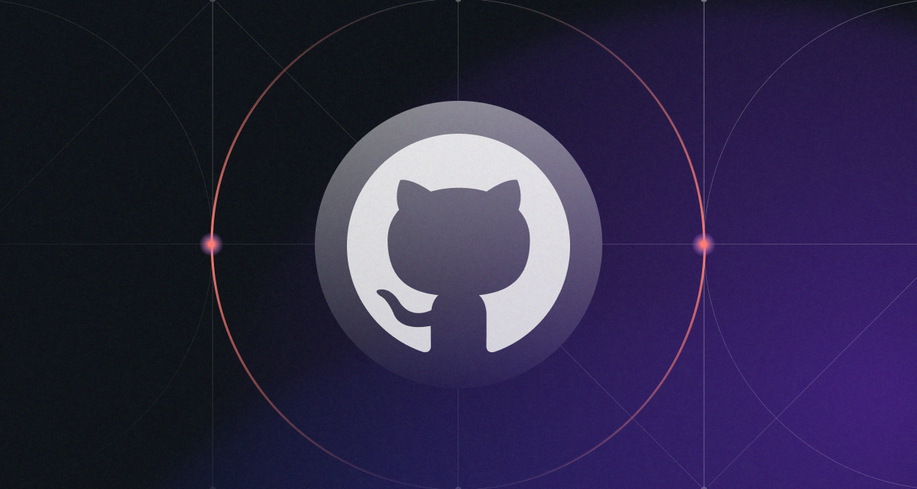
CODE Management
Notes:
We used github for version control and code sharing so that we could access the latest code from anywhere, and revert changes if we made a mistake.
Outside of the lab time slots, we used text messages to communicate with one another to discuss when we were going to meet in the lab to work on the project.
When we started the project on June 2nd, we established that by the following Friday we wanted both the gameplay and game logic parts of the project fully integrated. So over the next week, we worked on separate Python files to get our individual parts working together.
Then starting on Thursday June 8th, we started working to combine the two interfaces to create the complete game. This involved converting the game logic to a Python class, placing it in the file with robot controller, and then figuring out how to call the necessary functions from the robot controller class using the game logic class, enabling the user to play the game in a seamless way.

Slide 16
Video Demo
5
But does it work?

Slide 17


King and Double Jump Demo
Notes:
Disclaimer: This video is running at two times speed in order for us to be able present certain intricacies of the game in a timely manner.
In the first clip a cylinder is shown making it to the back of the board which means that it becomes a king. Because of this the piece is now capable of moving and taking pieces behind it as seen in the following clip.
The second clip showcases a normal cylinder double jumping. As seen in the clip the user takes a piece and then is prompted with another turn to see if the user would like to or has the piece in a position where double jumping is possible. In this scenario the double jump was in fact possible as can be seen by two pieces being taken in a row.

Slide 18
Conclusion
6
What’s the point?

Slide 19
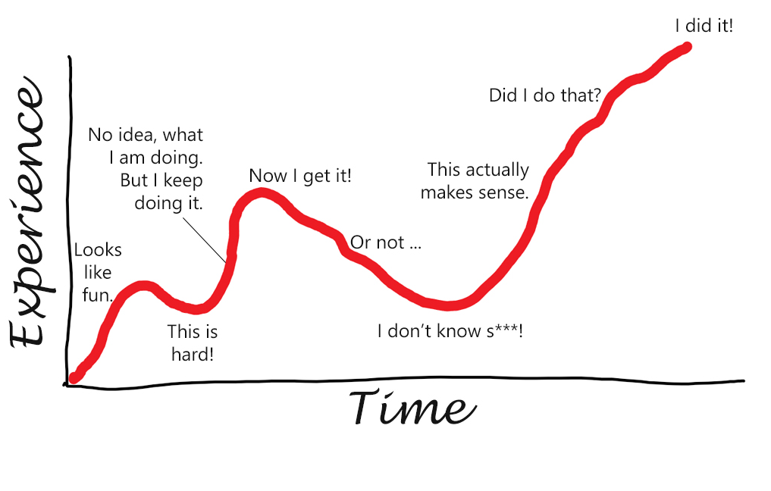
Conclusion
We are here
We don’t always think of intricacies
Constructing the scene in Rviz was difficult
We got a functioning game
We have a great foundation for future robotics projects
Notes:
Overall this was a fantastic learning experience and really helped to get us acquainted with ROS and Python as most of us had either little to no exposure to either or prior to this project.
Games like checkers present a lot of issues due to intricacies that aren’t necessarily thought about when a person is playing a game however it was a great learning experience and very insightful from an algorithmic perspective to construct such a game in python.
Constructing the board and the environment in ROS also proved to be difficult however knowledge was gained about how to use markers and build the board to show up in Rviz.

Slide 20
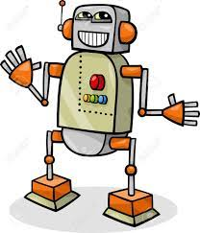
Future Work
Implement a better path planning algorithm
We want a robot playing checkers in the lobby of SCDI
Implement game logic for chess
Notes:
We are using tf2 for path planning, which is probably the simplest path planning algorithm available in ROS, but I did not have the time to implement anything more advanced.
Implementing a more advanced path planning algorithm like CHOMP or STOMP would definitely improve the game experience because it would allow the robot to grab the pieces more accurately every time and make calculations faster, but for the beta version of the game, tf2 works pretty well.
Additionally, in the future we want to have a live, interactive display of a robot, probably something much smaller, playing checkers in the lobby of SCDI so that when the business students show off our engineering school they can talk about our robotics opportunities and not engineering 1 (we all hate that class).
Lastly, in the future we could add a chess gameplay mode; for the purposes of this project, checkers was a lot easier to implement on the logic side and the user interface side. But checkers seems more doable now as the checkers implementation is a lot of the groundwork for chess so chess would be at most a lateral move at this point.

Slide 21

Thanks for Listening!
Have a great summer!

